Slide 1

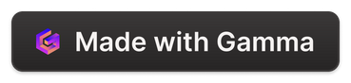
Blog Generation Using LLaMA 2 and Streamlit
This presentation explores blog generation. We'll leverage LLaMA 2 and Streamlit. LLaMA 2 is a powerful language model. Streamlit will create an interactive web app.

Slide 2
Introduction to LLaMA 2
LLaMA 2 is a cutting-edge language model. It excels at understanding and generating text. It's perfect for creating blog content.
Transformer-Based
Pre-trained
Fine-tunable
LLaMA 2 uses a transformer architecture. This enables parallel processing and long-range dependencies.
It is pre-trained on a massive dataset of text. This gives it a broad understanding of language.
It can be fine-tuned for specific tasks like blog writing. This customization improves performance.

Slide 3
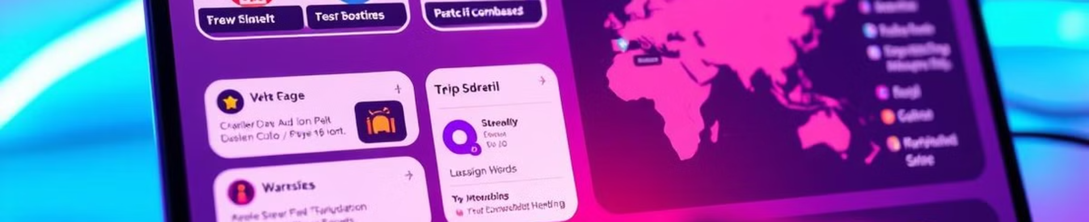
Streamlit: Interactive Web Apps
Streamlit simplifies web app creation. It allows Python developers to quickly build apps. No front-end experience is needed.
Pythonic
Interactive
Easy Deployment
Write apps using familiar Python code. Focus on your data and model logic.
Add widgets like sliders and buttons. These widgets enhance the user experience.
Deploy apps with a single command. Share your work with the world.

Slide 4




Integrating LLaMA 2 & Streamlit
Combine LLaMA 2's text generation with Streamlit's ease of use. Build a blog generation app with a user-friendly interface.
Input Prompt
User provides a prompt or topic.
LLaMA 2 Generates
LLaMA 2 creates blog content.
Streamlit Displays
Streamlit shows the generated blog.

Slide 5




Collecting Data for Blog Generation
Data collection is vital. Use it to fine-tune LLaMA 2. This enhances its blog writing capabilities.
Web Scraping
Existing Datasets
Custom Data
Gather data from blogs. Target relevant websites and articles.
Leverage existing text datasets. Filter for blog-like content.
Create your own dataset. Write blog posts on specific topics.

Slide 6

Implementing the Pipeline
Building the pipeline is a step-by-step process. Start with data preprocessing. Next, fine-tune LLaMA 2. Finally, integrate with Streamlit.
Data Cleaning
1
Remove irrelevant characters. Convert text to lowercase.
Fine-tuning
2
Train LLaMA 2 on your dataset. Optimize for blog writing style.
Streamlit Integration
3
Connect LLaMA 2 to your Streamlit app.

Slide 7

Generating Engaging Content
Use LLaMA 2 to create compelling blog posts. Experiment with different prompts. Adjust parameters for desired output.
1
Prompt Engineering
2
Parameter Tuning
3
Iterative Refinement
Craft effective prompts. Guide LLaMA 2 for specific topics.
Adjust temperature and top-p. Control the creativity.
Generate, review, and refine. Improve the blog's quality.

Slide 8
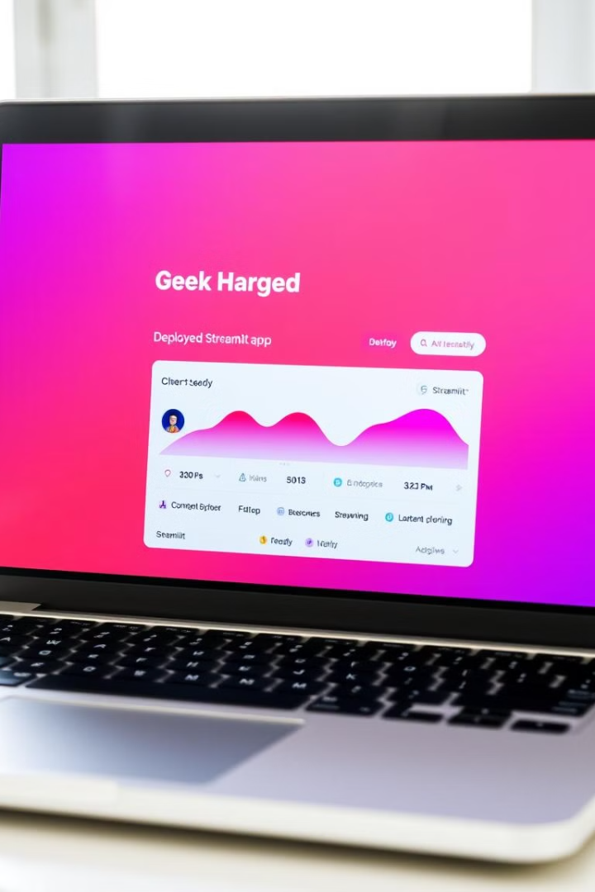
Deploying the App
Share your app with the world. Streamlit offers easy deployment. Use Streamlit Cloud or other platforms.
1
2
Prepare Code
Deploy
Ensure your code is ready.
Use Streamlit Cloud.
3
Share
Share the link.

Slide 9
Blog Generation Using LLaMA 2 and Streamlit
This presentation explores blog generation. We'll leverage LLaMA 2 and Streamlit. LLaMA 2 is a powerful language model. Streamlit will create an interactive web app.

